Slide 1

Notes:
Holding slide
1. CHECK
• Have I spoken with the class teacher/Head of Year, first? (Discussed safeguarding issues, emotional and actual – drug related - content of the presentation).
Explain that if any child has a concern or worry, or wants to talk to anyone as a result of this presentation, there are people available in school, and their trusted adults, who they can go to. Name the people, and include yourself.

Slide 2






Notes:
I’m going to start with a question for you all.
If I offered you some money, or maybe some new trainers of your own choice, perhaps free food and alcohol, all just because I thought you were really special, and important, and I truly cared about you, who’d say, no thanks?
If these things were offered, perhaps by someone you kind of knew rather than a complete stranger, you might accept?
Some of you might think.. Nothing is truly for free – there has to be a catch…

Slide 3

Child Criminal Exploitation
CCE
Notes:
If I said, ‘drug dealing’ – anyone heard of this – put your hand.
There are now so many drug pushers in towns and cities that they are starting to sell to people further away, and they use phone ‘lines’ to do this selling. For this reason it has sometimes been called County Lines. When they have sold to a person in another town, how are they going to get it to them?
They can’t post it. They need someone to deliver it personally.
People who make children do this are exploiting them.
It is wrong. It’s against the Law. The child is not to blame.

Slide 4
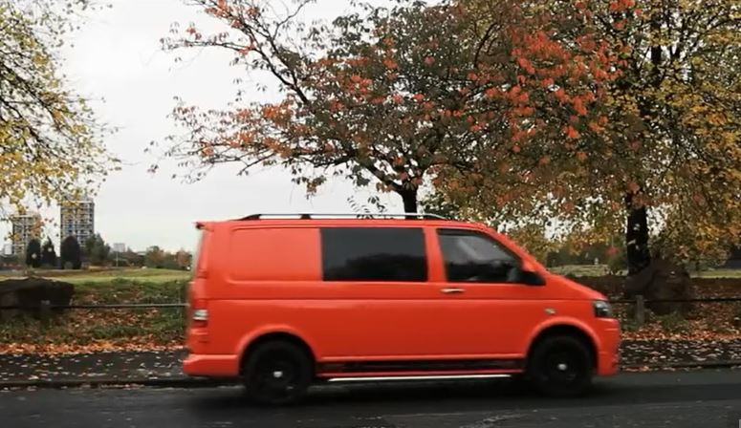
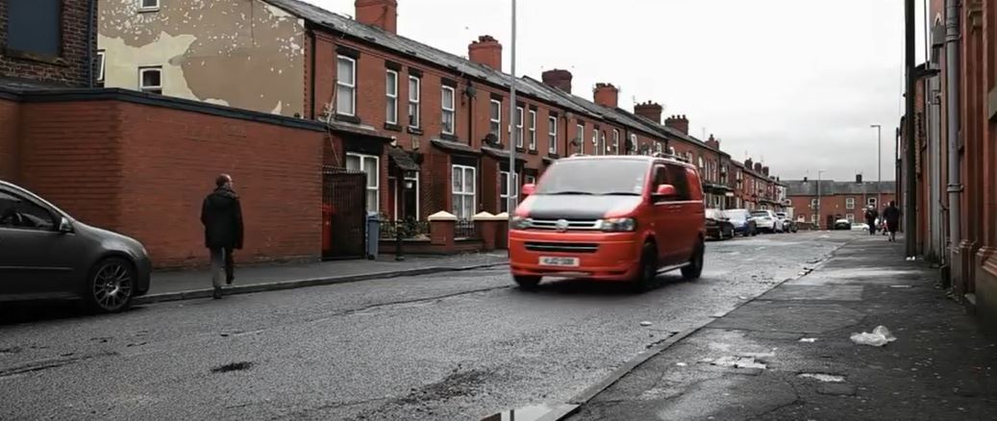

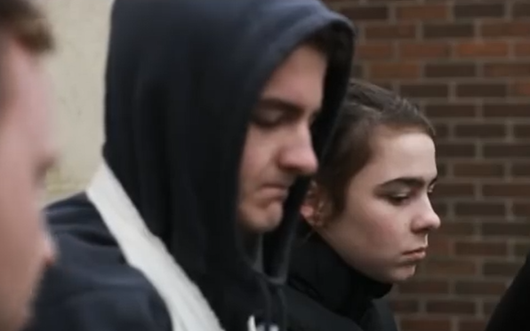
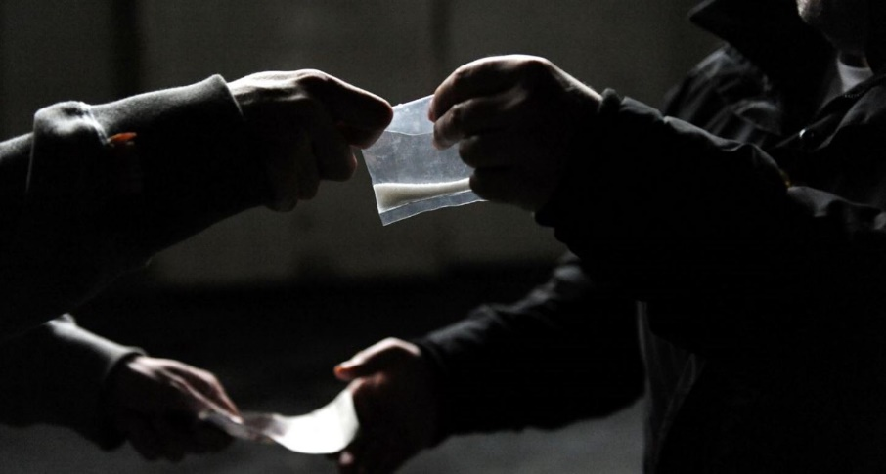
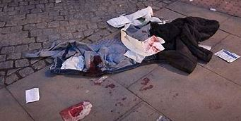
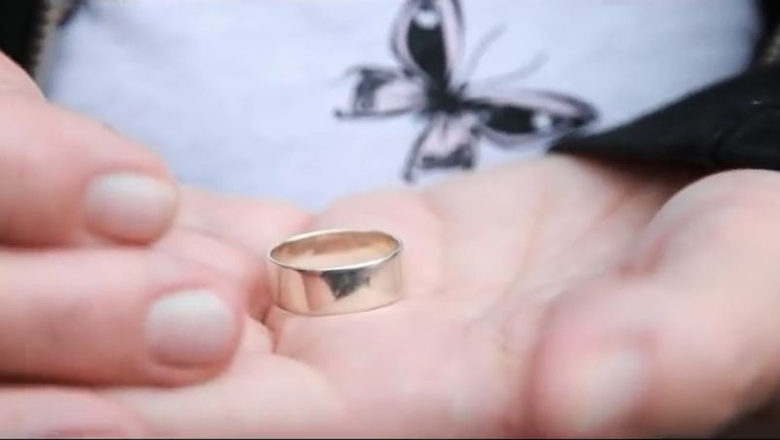

Notes:
Now I’m going to ask you another question.
If I asked, who would like to be taken away from home, to a place you don’t know, in the back of a van, where you can’t see out of the windows, how many of you would go?
I’ll tell you a bit more about it, and see if it helps you make a decision.
You don’t know where you’re going or how you’ll get home. When the van stops (and you will know the driver, whether you like them or not is another matter), you’re are told to get out. You won’t recognise the area, but you’ll be given drugs to sell, and told you won’t be taken home until you have sold all the drugs.
You may think you’d just call a member of your family, or someone you know, but your phone is taken from you. You will be in a risky, dangerous situation, and you’ll feel scared and in danger. Your family will be worried sick about you, and they may feel pressured to sell belongings or even steal to ‘buy’ you back.
There is a chance you may get seriously injured or worse.
Would anyone like to go?
Obviously, I would hope that none of you would want to get involved with this.

Slide 5

Who are ‘groomers’?;
Groomers hide their true intentions and may spend weeks or months gaining a child’s trust. They may even try to gain the trust of the whole family to be allowed access to the child.
Who does it?
Usually in person, but could be online
Stranger, someone you recognise, someone you know well or may even be a family member
Male or female
Child or adult
Well dressed, smart clothes, rich, casual
Friendly, kind and understanding but becoming threatening and controlling over time
Notes:
None of you put your hands up, but there are thousands of children in the UK doing just this, and it’s happening here, in Yorkshire and the Humber, to children as young as 10 years of age!
How do the drug dealers get you to do this dangerous stuff?
They do something called ‘grooming’
Make it clear that it is quite likely to be someone the child already knows.
Read through the information on the slide. Allow children to ask questions.

Slide 6
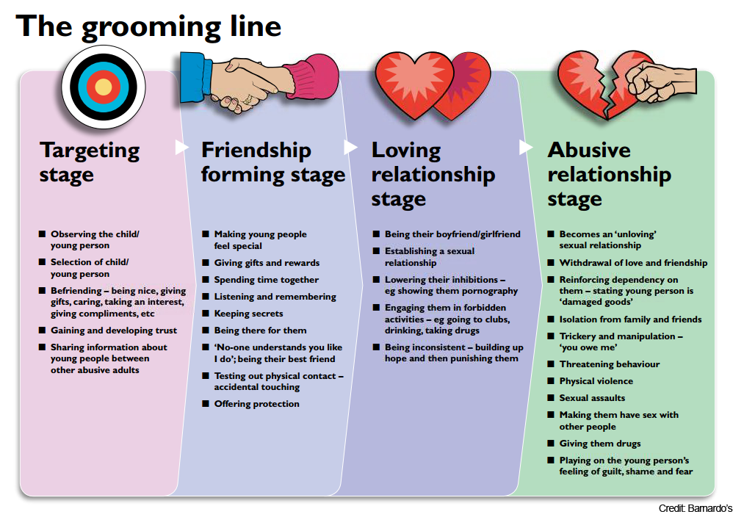
Notes:
There may be some children willing to commit crime but are too young to be making those decisions. Children will be manipulated due to the power imbalance present.
Child may feel that they are invincible under the protection of the OCG.

Slide 7

Alfie's Story Part 1 - YouTube

Slide 8

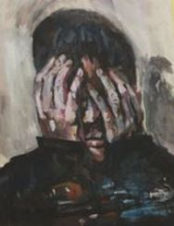
If you are worried about yourself or someone else…
Talk to a trusted adult – parent, teacher, me
Call ChildLine
ChildLine know about county lines
Notes:
Read through.

