Slide 1

PSHE and RSE @ Highburton First Academy
rElationships AND SEX education
Personal, Social, HeALTH, ECONOMIC EDUCATION
Parent Consultation
MONDAY 26th January 2026

Slide 2

RSHE – The Facts
Became compulsory in September 2020.
RSHE will link in with our PSHE curriculum.
RSHE – Relationships education, relationships and sex education and health education.
Health education – Physical health and mental wellbeing.
Relationships education – The physical, social, legal and emotional aspects of human relationships including friendships, family life and relationships with other children and adults.
Sex education – How a baby us conceived and born.
RSE – Relationships and sex education.
PSHE – Personal, Social, Health, Economic education.

Slide 3
RSHE – Teaching responsibility
Know and act in accordance with the RSHE policy.
Reflect the law (including the Equality Act 2010) as it applies to sex and relationships.
Consider how personal views or beliefs might impact teaching.
Report any safeguarding concerns to the DSL.
Share any concerns you have about teaching RSHE but also know that staff do not have the right to opt out of teaching RSHE.

Slide 4
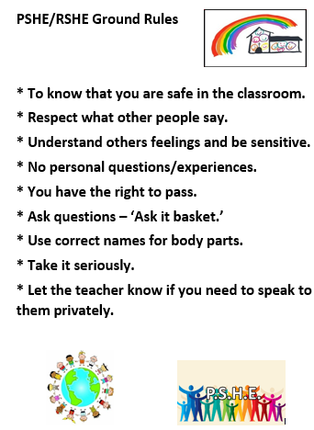
What are our PSHE ground rules?
Every class has the same set of ground rules.
These are read at the start of the lesson.
Ground rules are applied during discussions.
They are also used during small group tasks.
Ground rules support the behaviour policy.

Slide 5

Our RSE Curriculum
We use KAPOW RSE and PSHE units.
This is a programme that has updated and adapted the PSHE association which was recommended by the DFE.
Five key themes:-
* Family and Relationships * Health and Wellbeing
* Citizenship * Economic Wellbeing
* Safety and the Changing Body
We also allow time for responsive units and visits to occur.

Slide 6
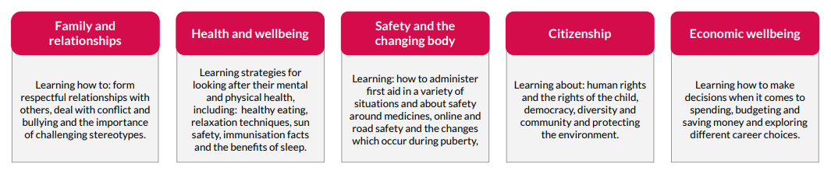
Our Long Term Plan
2022-2023 | Autumn One | Autumn Two | Spring One | Spring Two | Summer One | Summer Two
Reception | Self-Regulation – My Feelings | Building Relationships – Special Relationships | Managing Self – Taking on Challenges | Self-Regulation – Listening and Following Instructions | Building Relationships – My Family and Friends | Managing Self – My Wellbeing
Year One | Family and Relationships | Health and Wellbeing | Responsive Units | Citizenship | Economic Wellbeing | Safety and the changing body
Year Two | Family and Relationships | Health and Wellbeing | Responsive Units | Citizenship | Economic Wellbeing | Safety and the changing body
Year Three | Family and Relationships | Health and Wellbeing | Responsive Units | Citizenship | Economic Wellbeing | Safety and the changing body
Year Four | Family and Relationships | Health and Wellbeing | Responsive Units | Citizenship | Economic Wellbeing | Safety and the changing body
Year Five | Family and Relationships | Health and Wellbeing | Responsive Units | Citizenship | Economic Wellbeing | Safety and the changing body

Slide 7
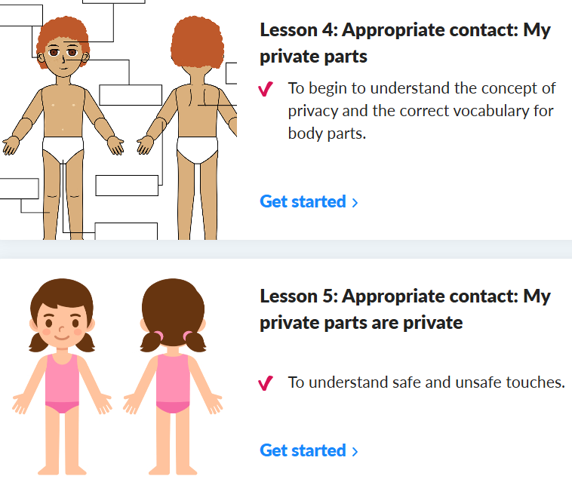
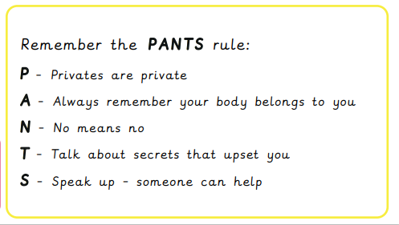

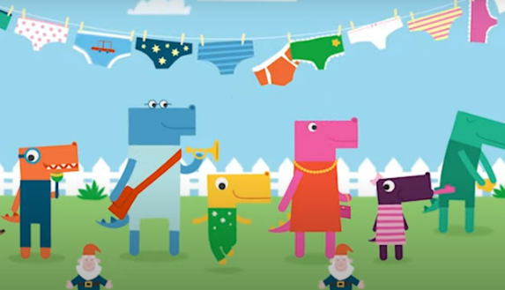
Key Lessons of RSE – Year 2
Year 2 – Lesson 4 and Lesson 5
Lesson 4 – Appropriate contact – What is privacy?
Lesson 5 – My private parts are private – Safe and unsafe touch
Pantosaurus
The Pantosaurus Song! | #TalkPANTS | NSPCC - Bing video

Slide 8
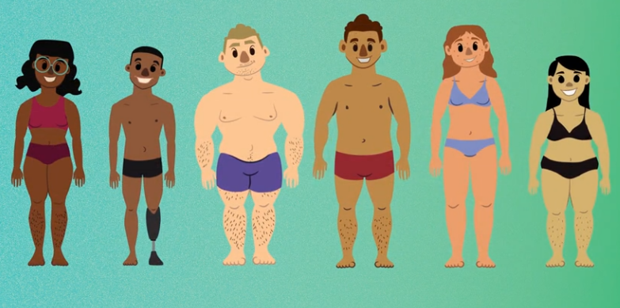
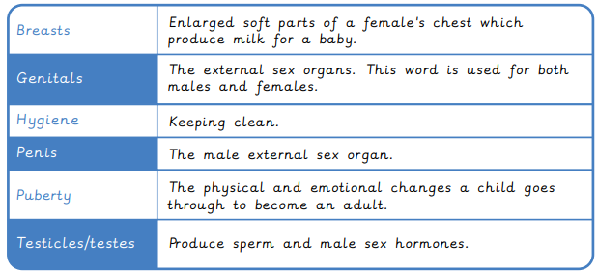
Key Lessons of RSE – Year 4
Year 4 – Lesson 6 and Lesson 7
Lesson 6 – Growing up – physical changes
Lesson 7 – Introducing puberty – changing from a child to an adult

Slide 9
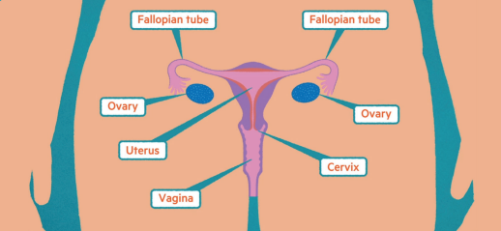
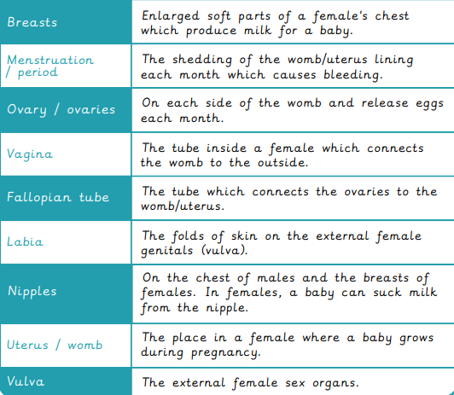
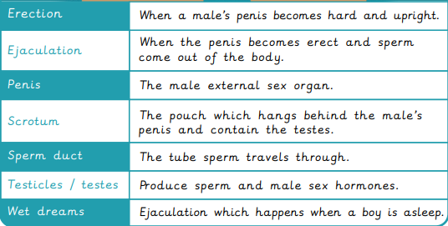
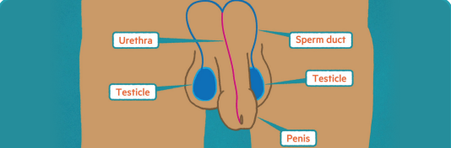
Key Lessons of RSE – Year 5
Year 5 – Lesson 3, Lesson 4 and Lesson 5
Lesson 3 – Puberty (Physical changes)
Lesson 4 – Menstruation (What are periods?)
Lesson 5 – Emotional changes in puberty

Slide 10

So how do we introduce difficult topics?
https://www.youtube.com/watch?v=4uOXUCiDE-s
A true story about two male penguins who fall in love.
They hatch the egg of another penguin.
Tango grows up with two loving daddies.

Slide 11
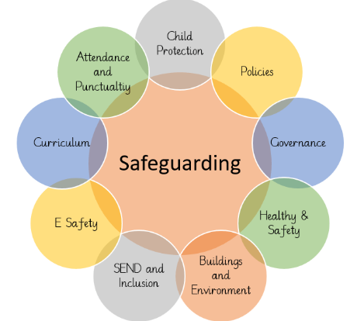
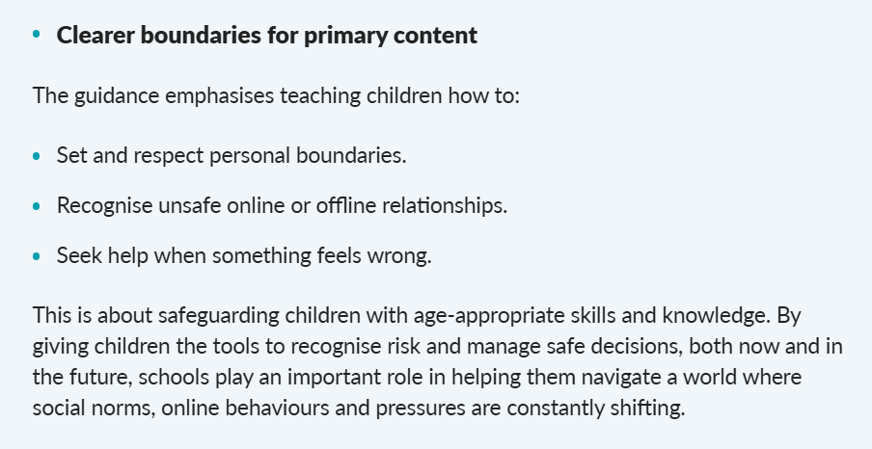
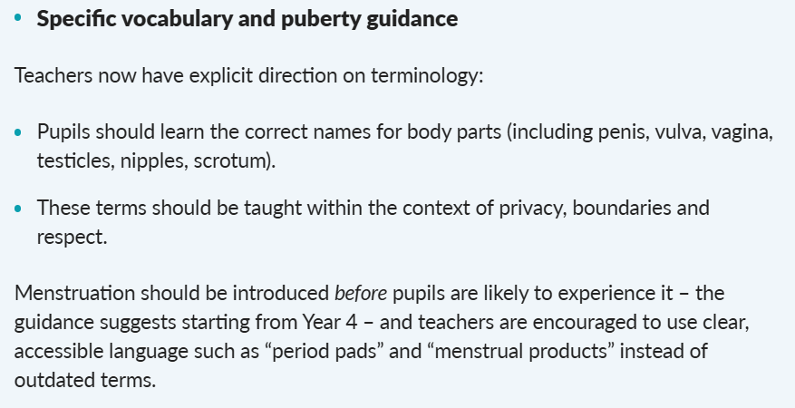
September 2026 updates

Slide 12

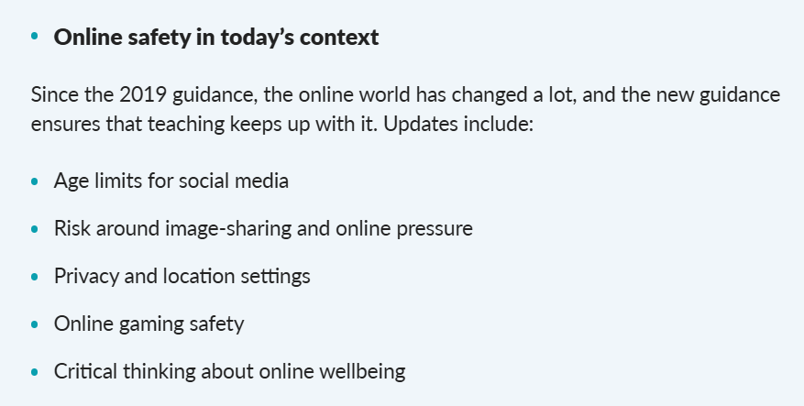
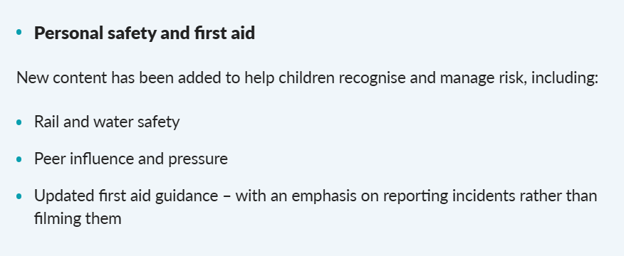
September 2026 updates

Slide 13

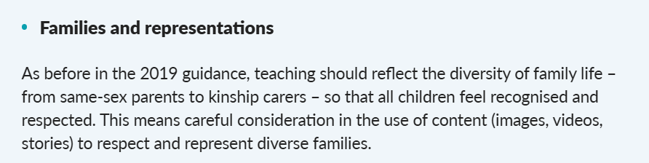
September 2026 updates
Mental Health and Wellbeing
* Develop an understanding of emotions.
* Change, loss and grief lessons.
Teaching RSE and Sex Education earlier
* Suggestions have mentioned moving sex education from Year 6 to Year 5.
* Discussions with other first schools in the pyramid.

Slide 14


Any comments or questions? QR Feedback Link

Slide 15

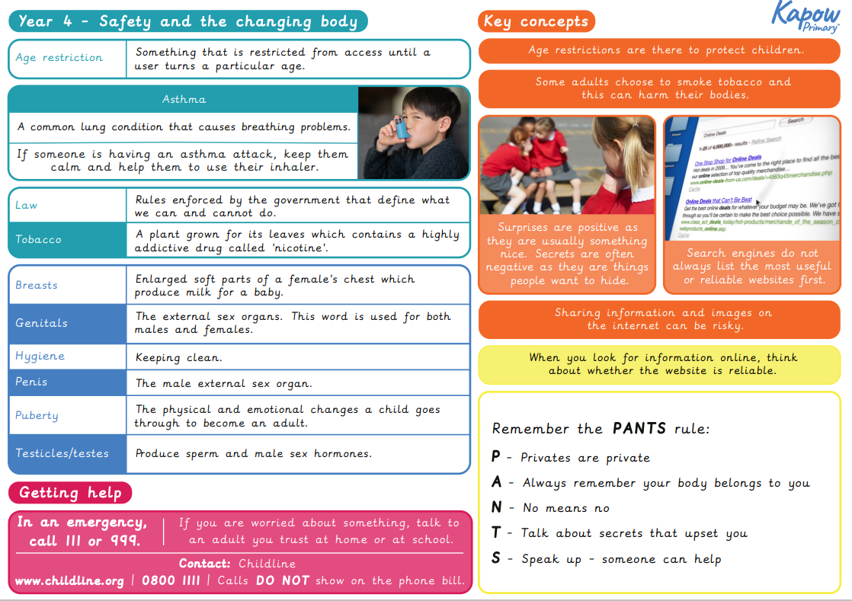
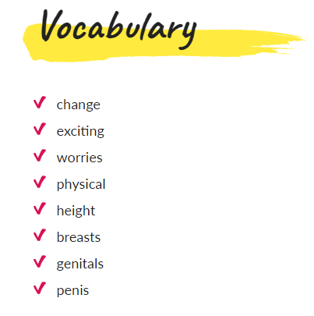
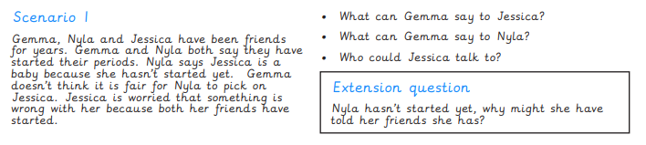
Time to look at resources
Knowledge Organisers
Planning Examples
Vocabulary Lists
Worksheets
Story Books

